Slide 1
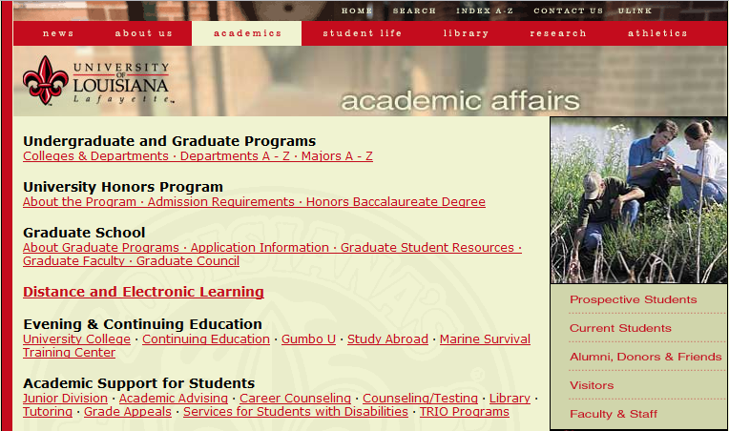

a subtle but visible change in top navigation bar styling, indicating we have left the home page and entered the site
Notes:
1) VISIBILITY

Slide 2
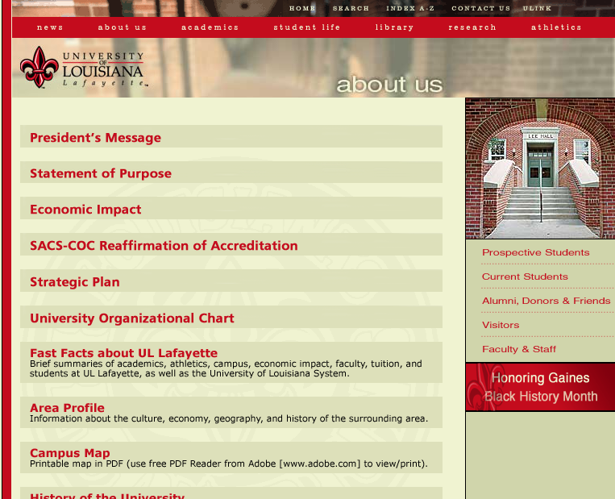
Notes:
2. LANGUAGE

Slide 3
Notes:
3. USER CONTROL

Slide 4
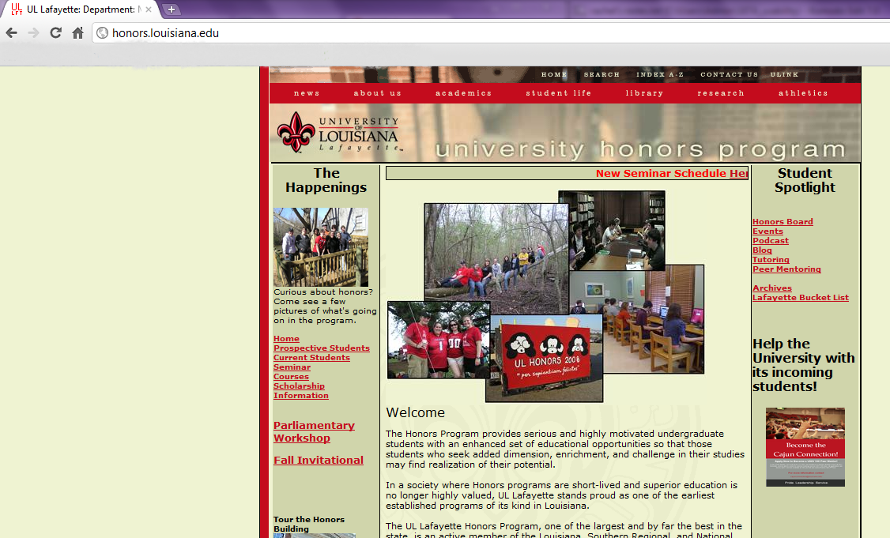


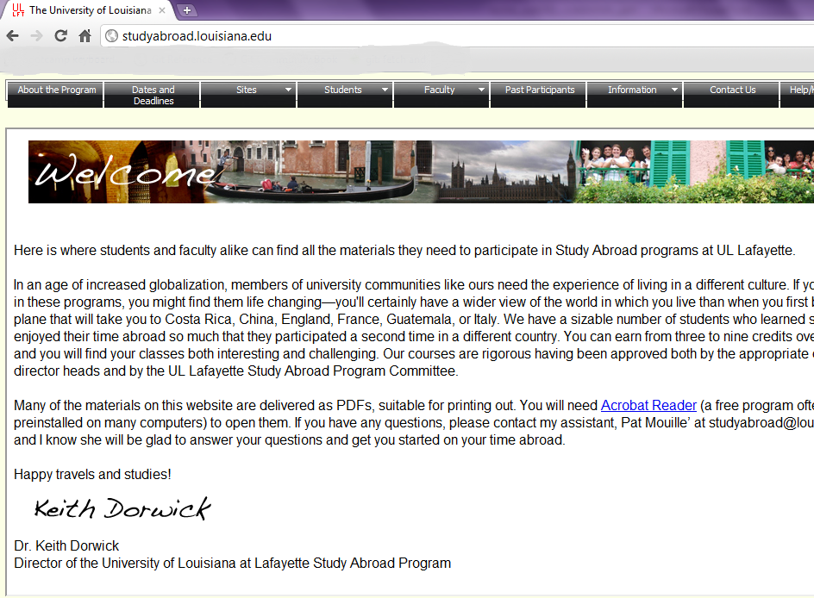
Notes:
4. CONSISTENCY
-

Slide 5
Notes:
5. ERROR PREVENTION

Slide 6
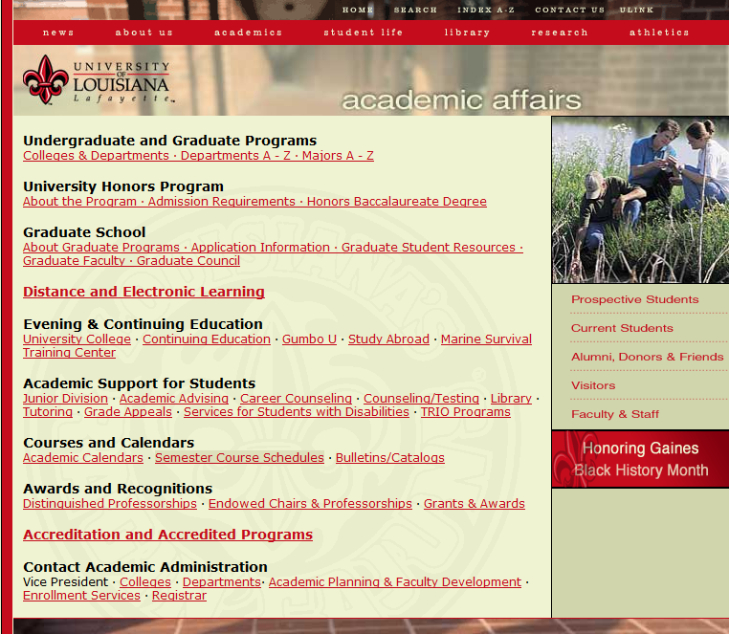
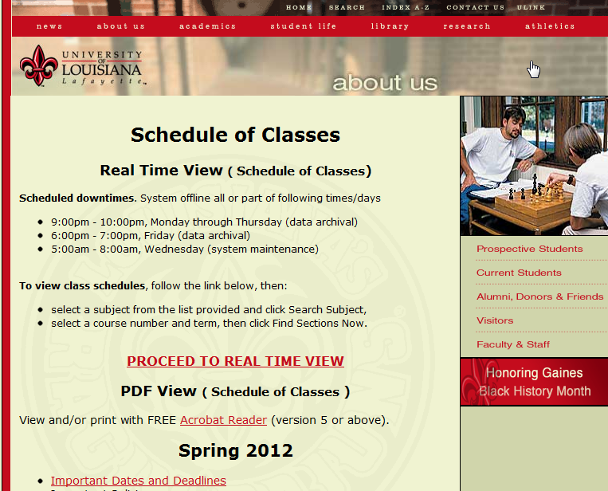
selecting a link from “academic affairs” somehow brings us to “about us”
Notes:
6. RECOGNITION:
-title header displays the overall topic for the content, but seems somewhat unpredictable and thus unreliable.
-certainly less effective than breadcrumbs, and reveals underlying lack of coherence in the information architecture
-if we happen to rollover the title header and notice the mouse cursor (not likely), we discover that the title header is clickable. no idea where it goes.

Slide 7
Notes:
8. FLEXIBILITY AND EFFICIENCY

Slide 8
Notes:
8. AESTHETICS

Slide 9
Notes:
9. ERROR RECOVERY

Slide 10
Notes:
10. HELP/DOCUMENTATION

